Slide 1
Rapid Application Development
(RAD)
Life Cycle Model

Slide 2
What is RAD?
Is a software development process model that has been developed to respond to the need to deliver systems very fast
Actually it allows usable systems to be built in as little as 3-6 months
It has been developed in the early 1990s
It takes inspiration from spiral model
Its goals are: faster, better, cheaper

Slide 3
When use RAD?
Project scope: focused, where the business objectives are well defined and narrow
Project data: already exist
Project decisions: can be made by a small number of people who are available and co-located
Project team: very small (six people)
Project technical architecture: defined and clear and the key technology components are well known
Project technical requirements: are reasonable and well within the capability of the technology being used
Intensive involvement of the end user in the design of the system (JAD, Joint Application Development)

Slide 4
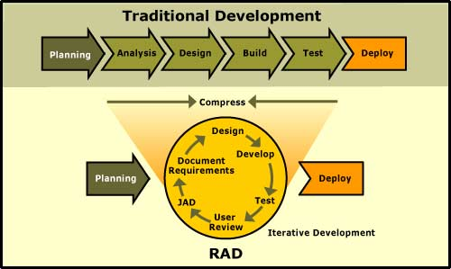
RAD development cycle

Slide 5
Rapid Application Model (RAD)
Requirements planning phase (a workshop utilizing structured discussion of business problems)
User description phase – automated tools capture information from users
Construction phase – productivity tools, such as code generators, screen generators, etc. inside a time-box. (“Do until done”)
Cutover phase -- installation of the system, user acceptance testing and user training

Slide 6
RAD Strengths
Reduced cycle time and improved productivity with fewer people means lower costs
Time-box approach mitigates cost and schedule risk.
Customer involved throughout the complete cycle minimizes risk of not achieving customer satisfaction and business needs
Focus moves from documentation to code (WYSIWYG).
Uses modeling concepts to capture information about business, data, and processes.

Slide 7
RAD Weaknesses
Accelerated development process must give quick responses to the user
Risk of never achieving closure
Hard to use with legacy systems
Requires a system that can be modularized
Developers and customers must be committed to rapid-fire activities in an abbreviated time frame.

Slide 8
When to use RAD
Reasonably well-known requirements
User involved throughout the life cycle
Project can be time-boxed
Functionality delivered in increments
High performance not required
Low technical risks
System can be modularized

